Slide 1
The Official Golfers' E-Letter of the Georgia PGA
RATES
2019

Slide 2
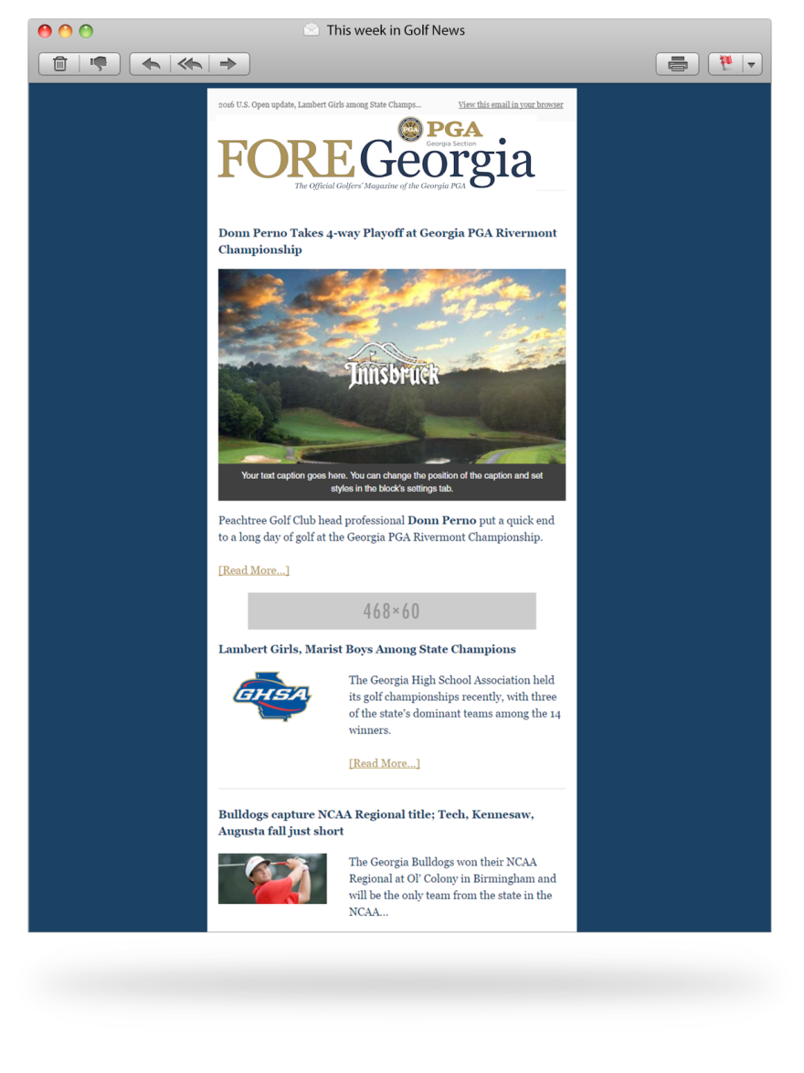
E- Letter Marketing
Featured Story Template
Featured story of the month
468 x 60 banner ads
Supporting stories/other news

Slide 3
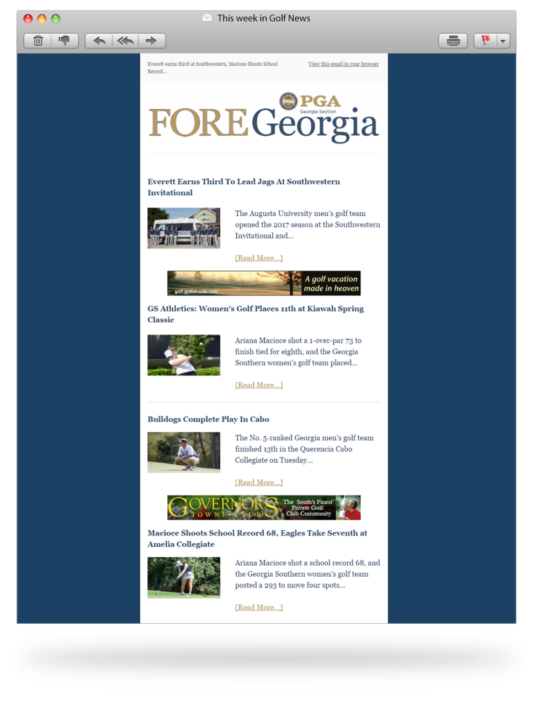
E-Letter Marketing
Regular feed template
Will have 5 news stories included
468 x 60 banner ads
468 x 60 banner ads

Slide 4
Banner Ads – 2 sizes (468x60) (728x90) $200 per month* Video Ads - :30 spots $300 per month Feature Article – Course of the Month $750* Display Ad Newsletter–600 x 665 pixels $750 Display Banners: Medium Rectangle (300 x 250) $200 per month Sky Scraper (300 x 600) $250 per month
E-Letter Advertising Rates
* Includes banners on E-Letter and Fore Georgia Home Page

Slide 5
40,000 Plus Circulation $2,000*
E-Blast Advertising Rate
*Additional 34,000 Facebook followers also increase your exposure
*Multiple Eblast qualify for the discount price of $1,700
*Copy due two (2) weeks in advance if not created
*Creative must be in html and is due one (1) week in advance

Slide 6
The Official Golfers' E-Letter of the Georgia PGA
2019
Call or email us at 404.200.4653
foregeorgia@comcast.net

